Slide 1

FY24 Budget Approval Meeting

Slide 2
Norms
This is a meeting of the GO Team. Only members of the team may participate in the discussion. Any members of the public present are here to quietly observe.
We will follow the agenda as noticed to the public and stay on task.
We invite and welcome contributions of every member and listen to each other.
We will respect all ideas and assume good intentions.

Slide 3
Agenda
Action Items (add items as needed)
  Approval of Agenda
  Approval of Previous Minutes
  Budget Approval Presentation
  Budget Approval (after final presentation/review and discussion)
Discussion Items (add items as needed)
  Presentation of the final budget
Information Items (add items as needed)
  Principal’s Report
    BASC-3 Results
Announcements

Slide 4

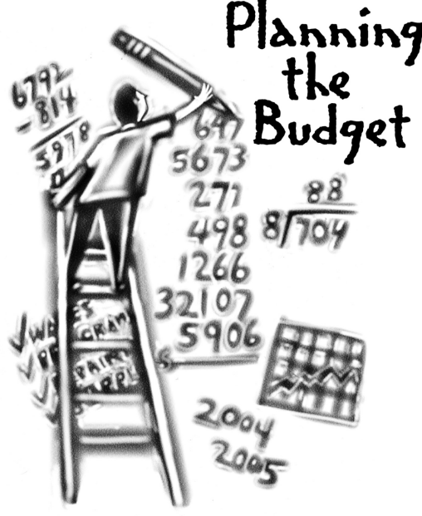
Overview of FY ‘24 GO Team Budget Process
Step 1 Review and Update Strategic Plan and Rank Strategic Priorities
By end of Fall Semester
Step 6 Principals: HR Staffing Conferences Begin
Late February – Early March
Step 3 GO Team Initial Budget Session: Allocation
January 24 – early February
Step 7 GO Team Final Budget Approval Meeting
Budgets Approved by March 17
Step 5
GO Team Feedback Session: Draft Budget Presented & Discussed
February – multiple meetings, if necessary
Step 4 Principals: Associate Supt. Discussions and Review
February (supports needed, specific challenges, coaching)
Step 2 Principals: Workshop FY 24 Budget
January 24, 2023
GO Teams are encouraged to have ongoing conversations about the school’s budget.

Slide 5
Budget Approval Meeting
What
During this meeting GO Teams will review the budget, which should be updated based on feedback from the staffing conference, Associate Superintendents, and key leaders. After review, GO Teams will need to take action (i.e., vote) on the FY24 Budget.
Why
Principals will present the final budget recommendations for GO Team approval.
When
All approval meetings must be held after staffing conferences. Budgets must be approved by March 17th.

Slide 6
Budget Review

Slide 7

FY24 Budget Parameters
FY24 School Priorities | Rationale
Increase STUDENT proficiency in Literacy and Mathematics | Strategic Plan Goals Increase the # of Teachers for Targeted, small group Instruction
Increase STAFF capacity in literacy instruction. | Increase # of support staff supporting teachers Increase Principal Support to free up time for Instructional Focus
Increase Staff capacity in data analysis and usage for instructional decision making. | There is a need for enhanced teacher support to be able to assist teachers with data analysis that will impact student learning
Notes:
Review the priorities that the GO Team has developed and the rationale for these priorities. Feel free to copy this slide if you have more than 3 priorities to account for.

Slide 8
FY24 Budget Parameters
FY24 School Priorities | Rationale
Utilize data to meet the individual needs of students. | Ensure that students are receiving maximized opportunities for achievement and remediation daily.
Monitor the communication to parents of students chronically absent. | Absent students affect the CCRPI score and adversely impact achievement.
FY24 School Prioriies | Rationale
Maintain lower class sizes in the primary ears by funding parapros in 1st and second grade | 47% mobility rate requires a great deal of teacher attention to students who enter our school throughout the year – many of which are below level.
Maximize wrap around services ie: Nurse, SSW, Counseling | This continues to be a need for our students, but we need to look closely at maximizing our budget to make this work.
Increase Reading/Lexiles and writing of 3rd – 5th grade students. How can we restructure our program to achieve this? | Data indicates that students who have been with us for more than one year have greater performance levels than students who are transient. With 47% of our students
Example
Notes:
Review the priorities that the GO Team has developed and the rationale for these priorities. Feel free to copy this slide if you have more than 3 priorities to account for.

Slide 9

Staffing Conference Changes
Principals –indicate on this slide if there were any changes made to your budget proposal at your staffing conference. If there were no changes, please just cover the Budget by Function on slides 7 & 8 as a quick summary for your GO Team. If there were changes, please summarize for your team and then discuss the NEW Budget by Function values.
There were any changes made to the draft budget we discussed at our last meeting.
These changes reflect an allocation change of +$132,970.

Slide 10
Summary of Changes
Change at Staffing Conference | Impact to Proposed Budget
Positions increased in Special Education to match the district FTE allocation. (District Allocated) | - Change in FTE on 1000 line - Increased the amount budgeted
2100 Change in Pupil Services – Psychologist FTE reduced (District Allocated) | - Change in FTE on 2100 line - Increased the amount budgeted
Abolished Master Teacher Leader Positions (2.5 FTE) | - Ability to have STEM teacher - Full Time Music
Added Instructional Support Staff Positions Turnaround Instructional Coach Business Manager Turnaround Reading/Math Teachers | NA

Slide 11
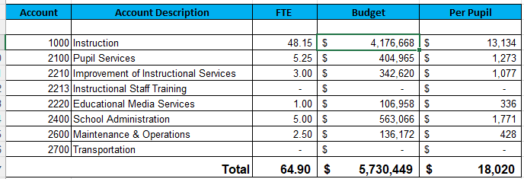
Budget by Function (Required)
*Based on Current Allocation of School Budget

Slide 12
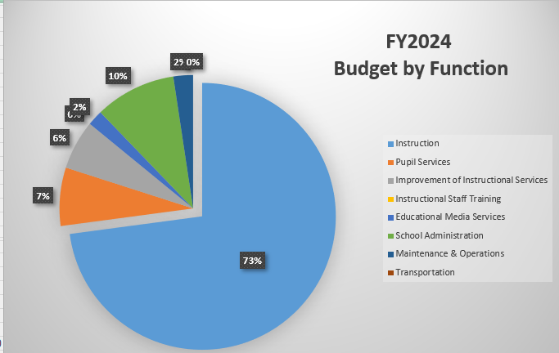
Budget by Function (Required)
*Based on Current Allocation of School Budget

Slide 13

Questions?

Slide 14
The GO Team needs to TAKE ACTION (vote) on the presented budget. After the motion and a second, the GO Team may have additional discussion. Once discussion is concluded, the GO Team will vote.
Action on the Budget

Slide 15

BASC-3 Data

Slide 16
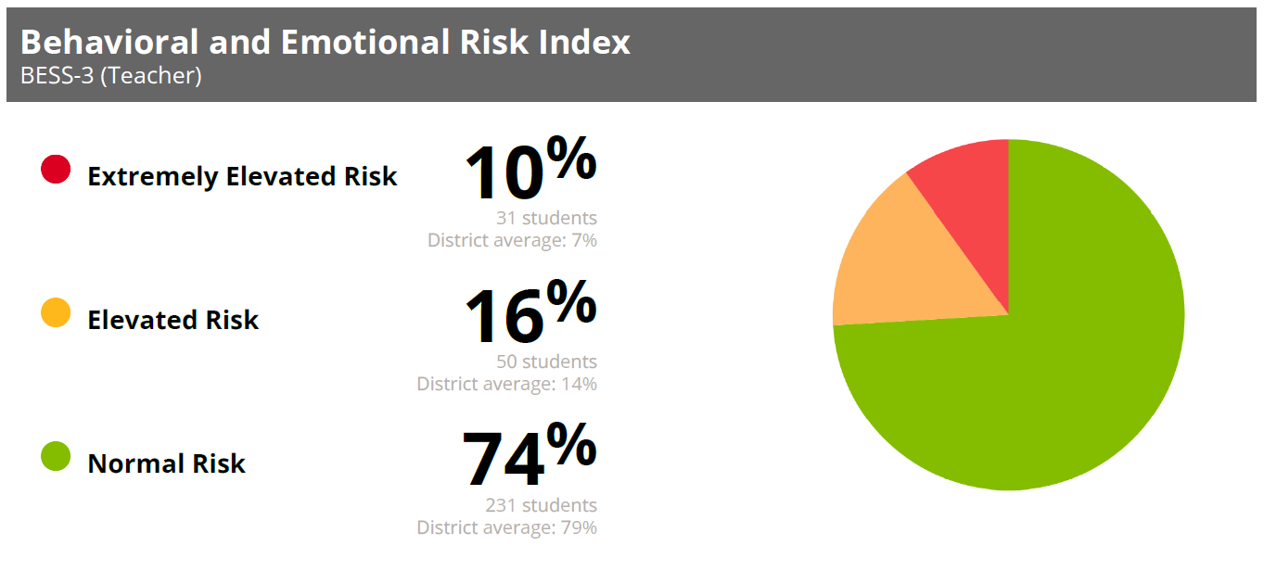
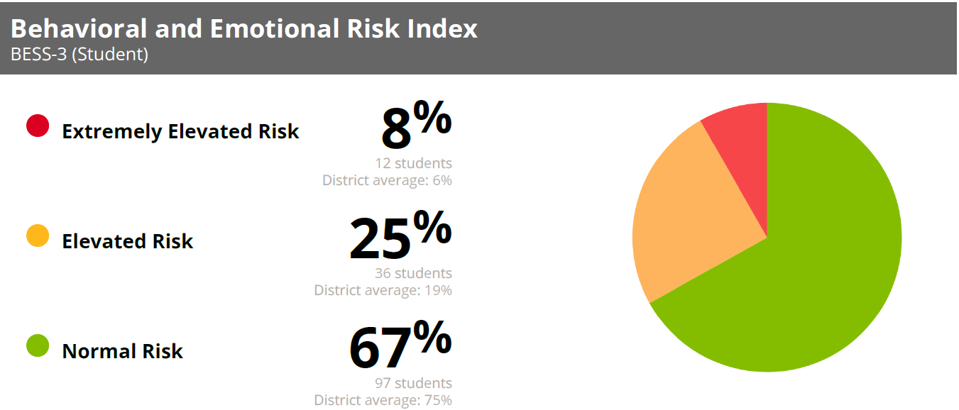
R-esdadfffadaCarCare

Slide 17
Questions?

Slide 18

Thank you

